Slide 1

PREDICTING PROBLEMATIC INTERNET USE IN CHILDREN AND ADOLESCENTS
Presented By : 2020/E/027
EC 9560 DATA MINING| 2024

Slide 2
2
OVERVIEW
Objective
Dataset Overview
Data preprocessing
EC 9560 DATA MINING| 2024

Slide 3
3
OBJECTIVE
1
Develop a model to predict the level of problematic internet usage in children and adolescents.
EC 9560 DATA MINING| 2024
Use data from HBN Instruments, including steps, activity hours, and fitness metrics, to predict internet usage behavior.
2
3
Identify early indicators for timely interventions, encouraging healthier digital habits.

Slide 4
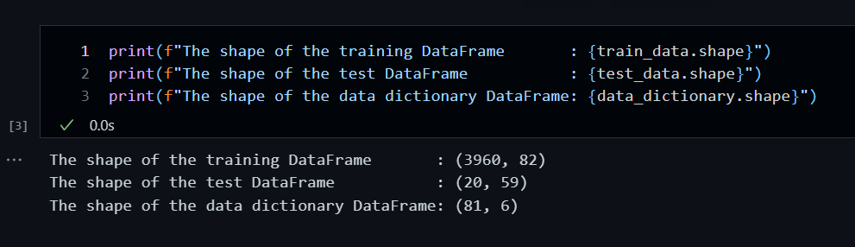
4
DATASET OVERVIEW
Source of Data:
Dataset structure:
Kaggle Competition Dataset — Child Mind Institute: Problematic Internet Use
train.csv
test.csv
data_dictionary.csv
EC 9560 DATA MINING| 2024

Slide 5
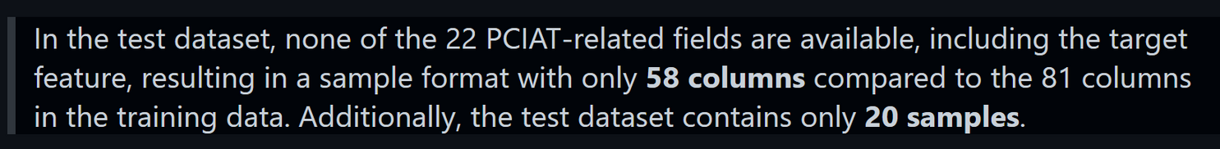
5
Features
Target
The training dataset includes 3,960 records of children and adolescents, each with 81 features (excluding the ID column).
The target variable is derived from the `PCIAT_Total` field, scored out of 100.
EC 9560 DATA MINING| 2024

Slide 6
DATA PREPROCESSING
EC 9560 DATA MINING| 2024

Slide 7
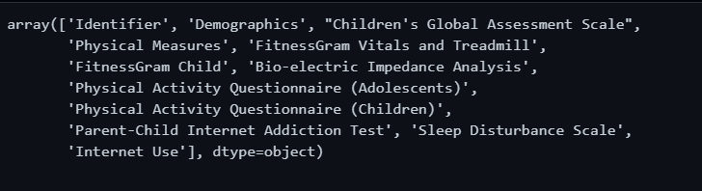
7
FEATURES
EC 9560 DATA MINING| 2024

Slide 8
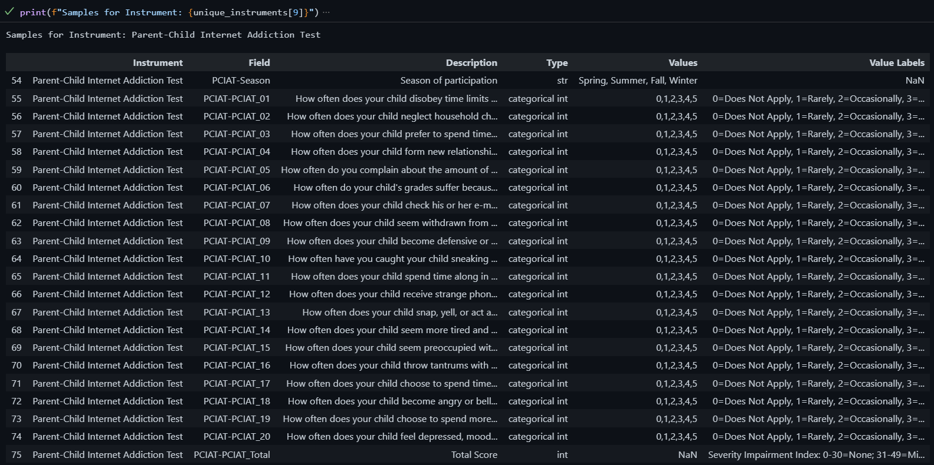
8
PCIAT FEATURES
EC 9560 DATA MINING| 2024

Slide 9
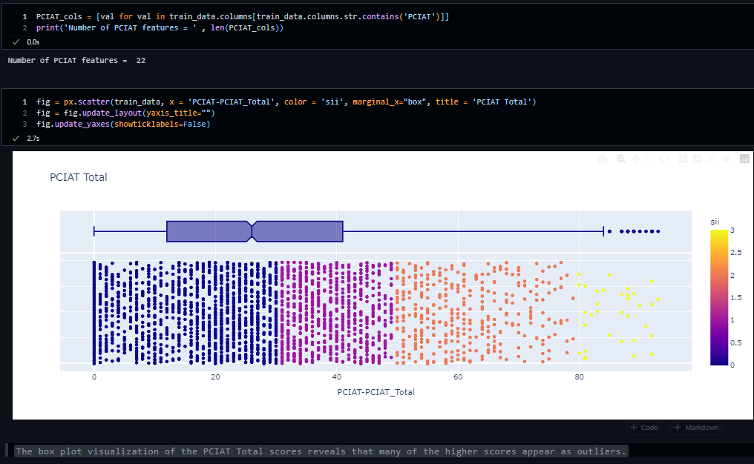
9
EC 9560 DATA MINING| 2024

Slide 10
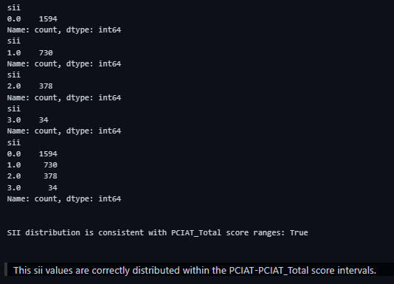
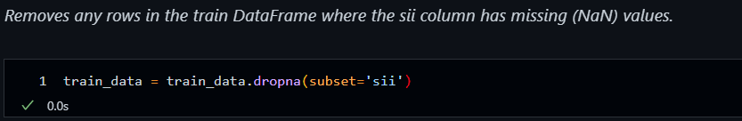
10
EC 9560 DATA MINING| 2024

Slide 11
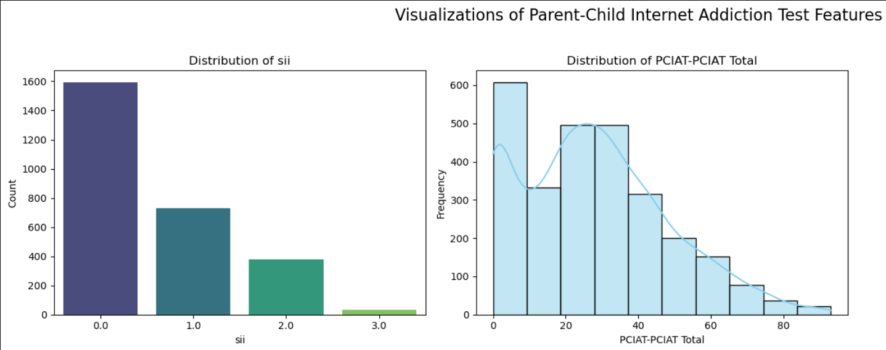
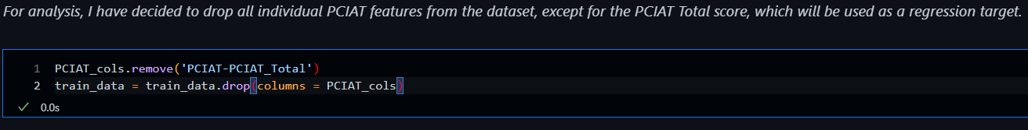
11
EC 9560 DATA MINING| 2024

Slide 12
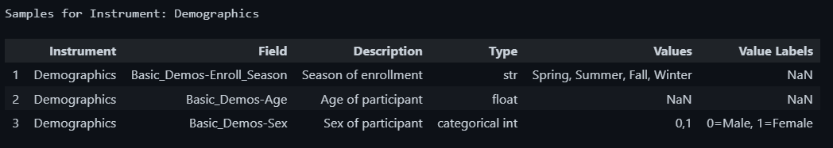
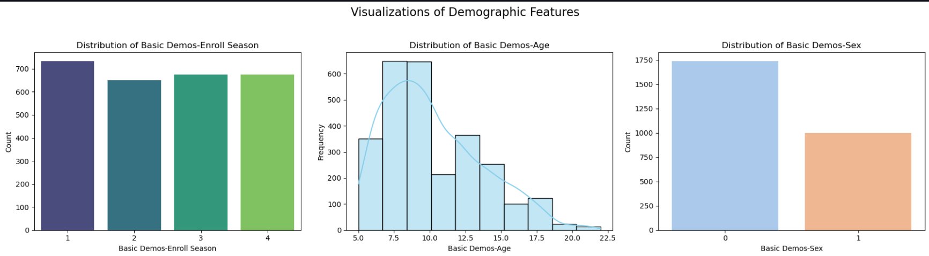
12
DEMOGRAPHICS FEATURES
EC 9560 DATA MINING| 2024

Slide 13
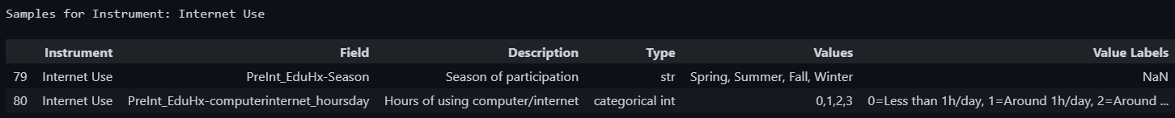
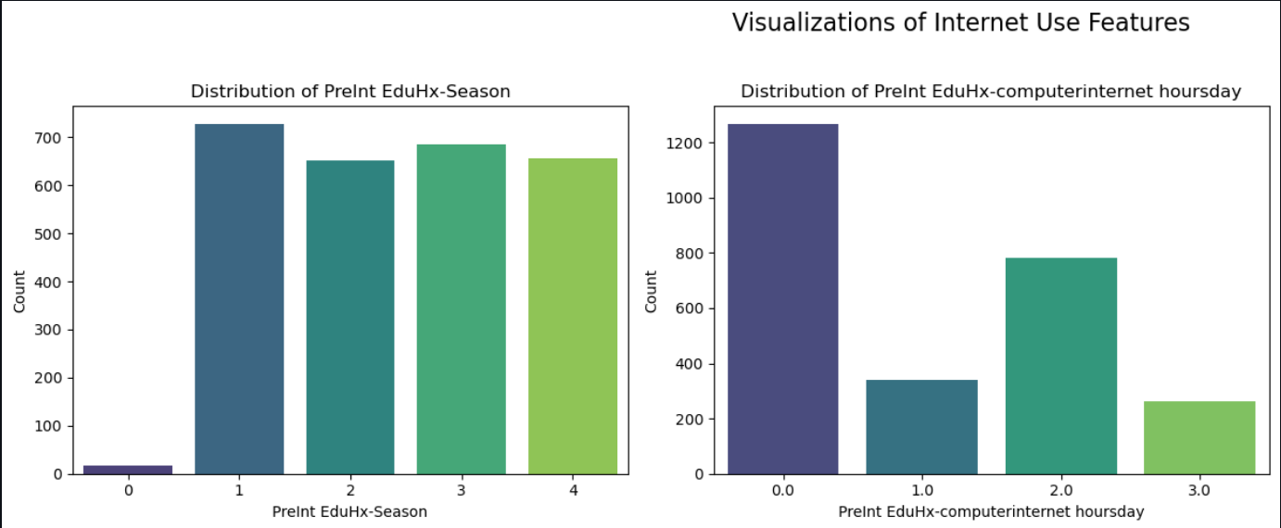
13
INTERNET USE
EC 9560 DATA MINING| 2024

Slide 14
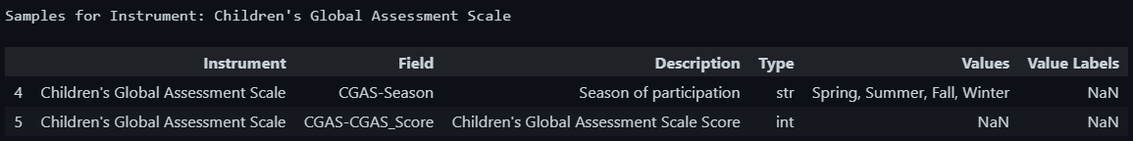
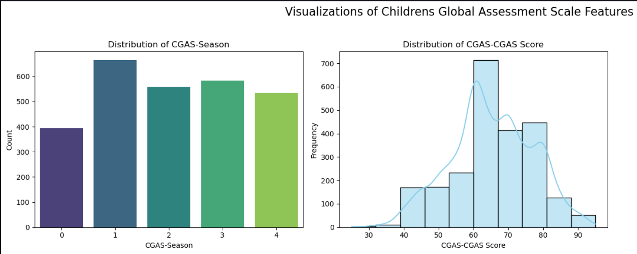
14
CHILDREN'S GLOBAL ASSESSMENT SCALE
EC 9560 DATA MINING| 2024

Slide 15
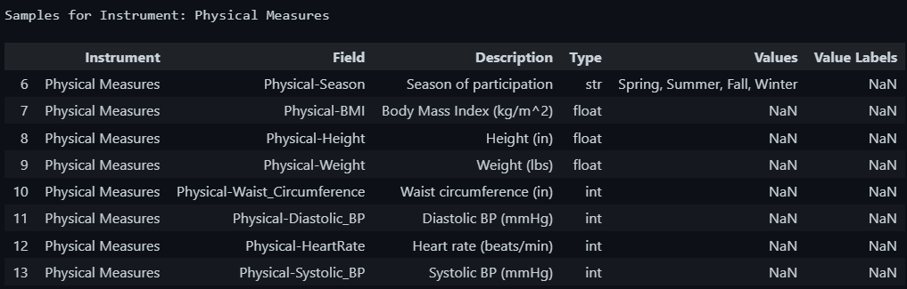
15
PHYSICAL MEASURES
EC 9560 DATA MINING| 2024

Slide 16
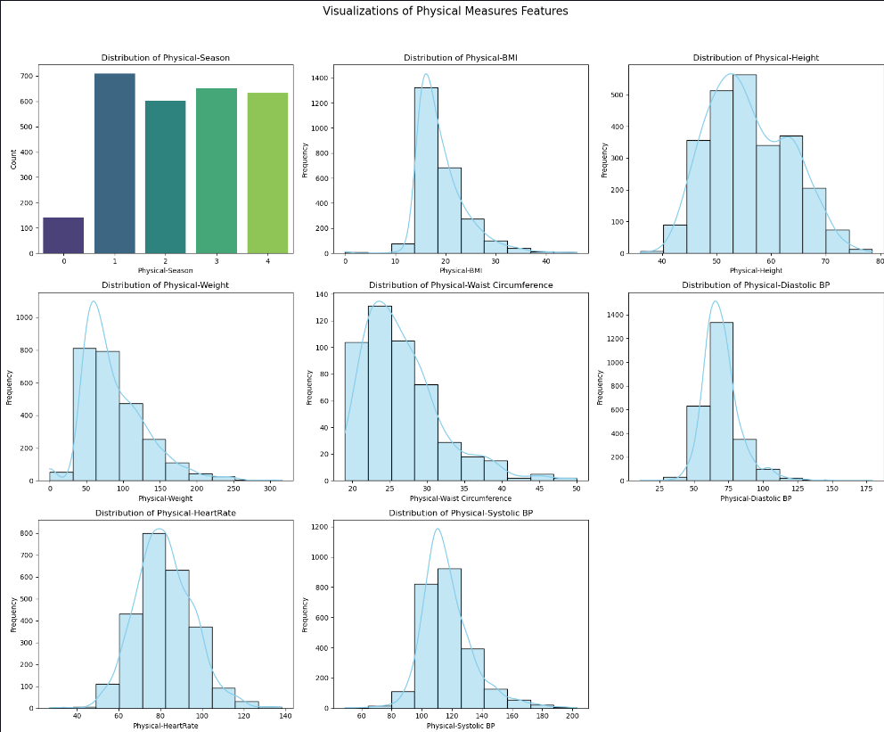
16
EC 9560 DATA MINING| 2024
EC 9560 DATA MINING| 2024

Slide 17
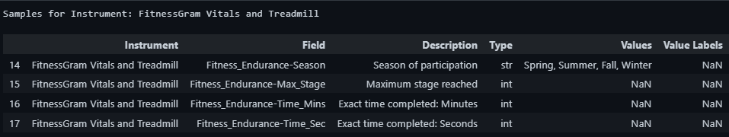
17
FITNESSGRAM VITALS AND TREADMILL
EC 9560 DATA MINING| 2024

Slide 18
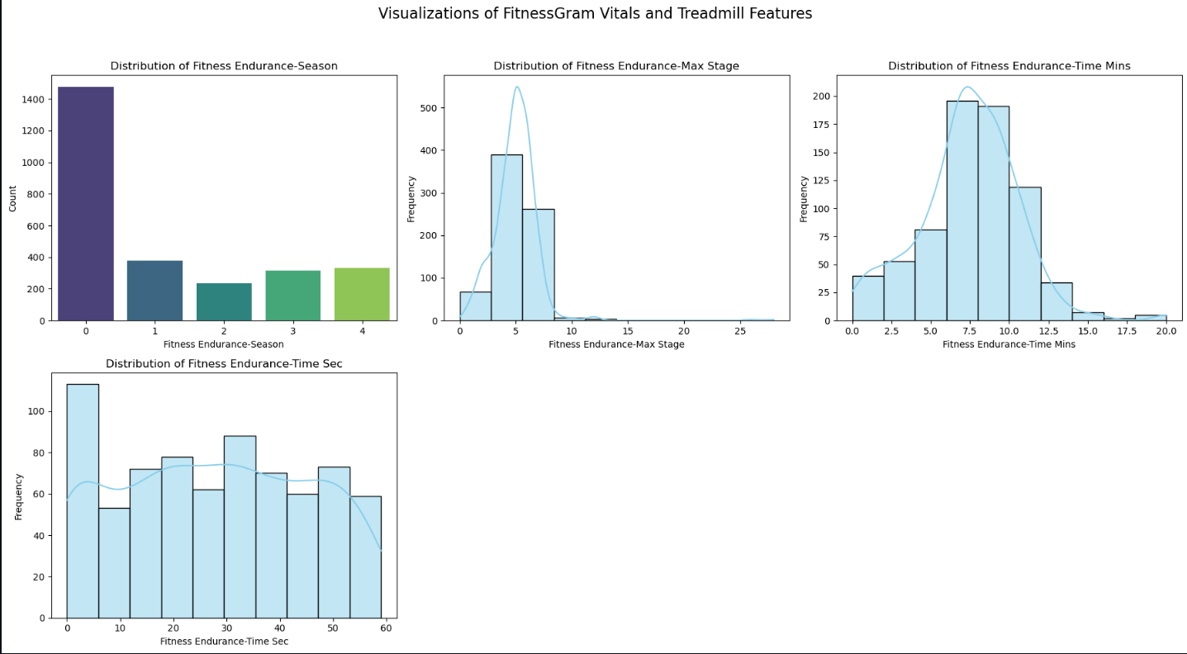
18
EC 9560 DATA MINING| 2024
EC 9560 DATA MINING| 2024

Slide 19
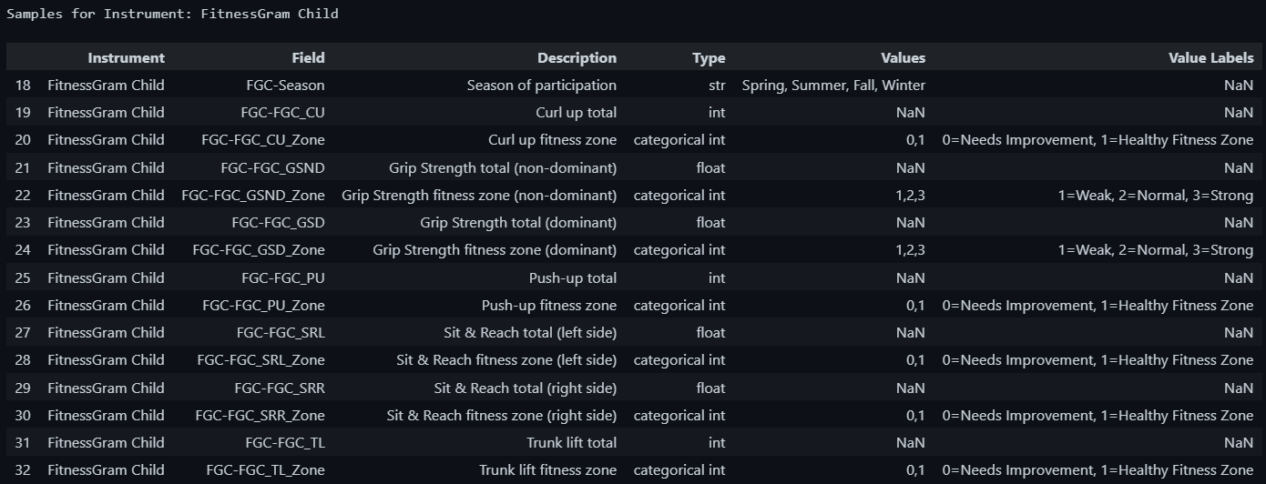
19
FITNESSGRAM CHILD
EC 9560 DATA MINING| 2024

Slide 20
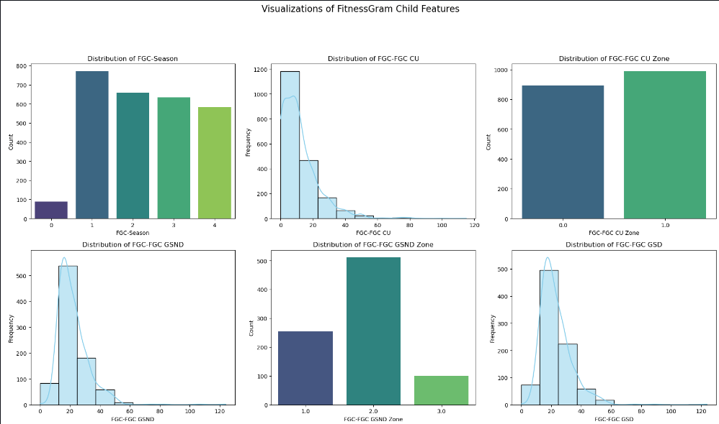
20
EC 9560 DATA MINING| 2024

Slide 21
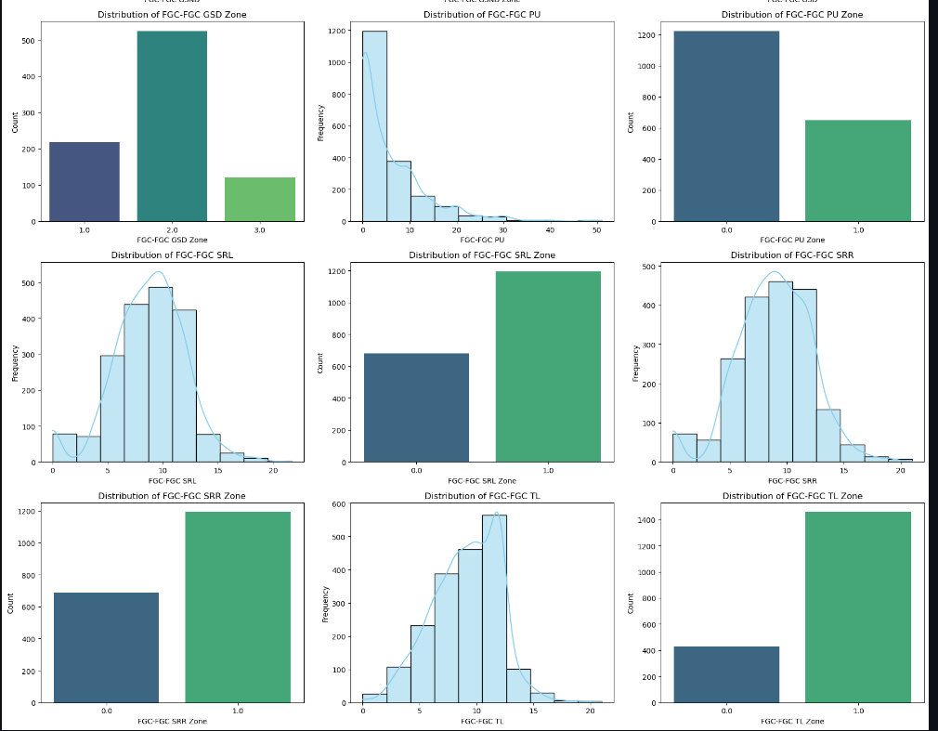
21
EC 9560 DATA MINING| 2024

Slide 22
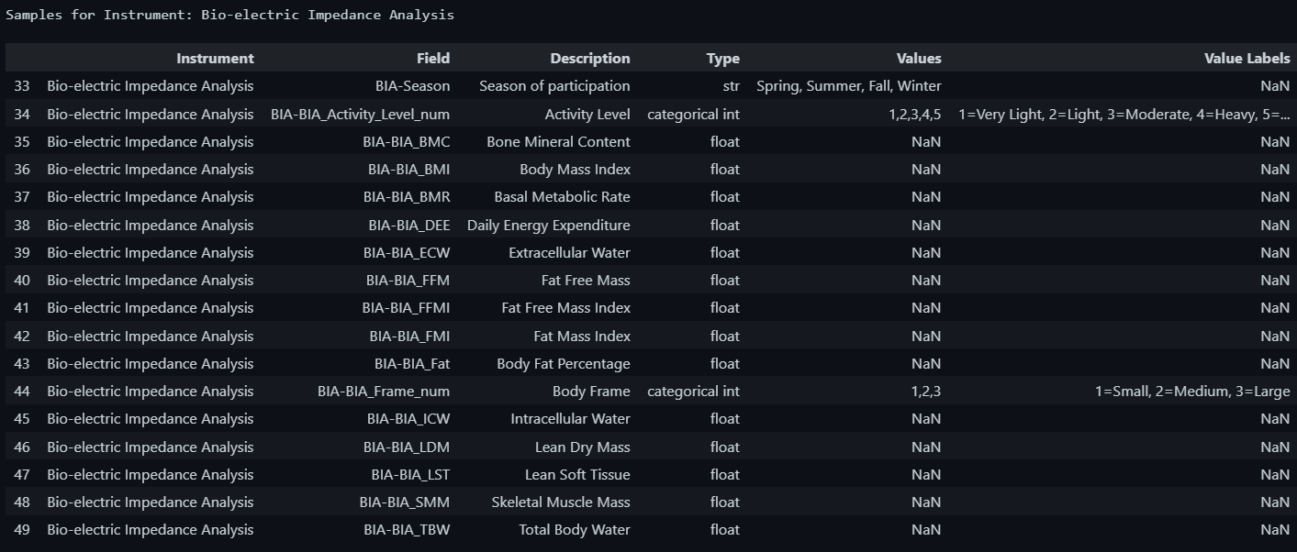
22
BIO-ELECTRIC IMPEDANCE ANALYSIS
EC 9560 DATA MINING| 2024

Slide 23
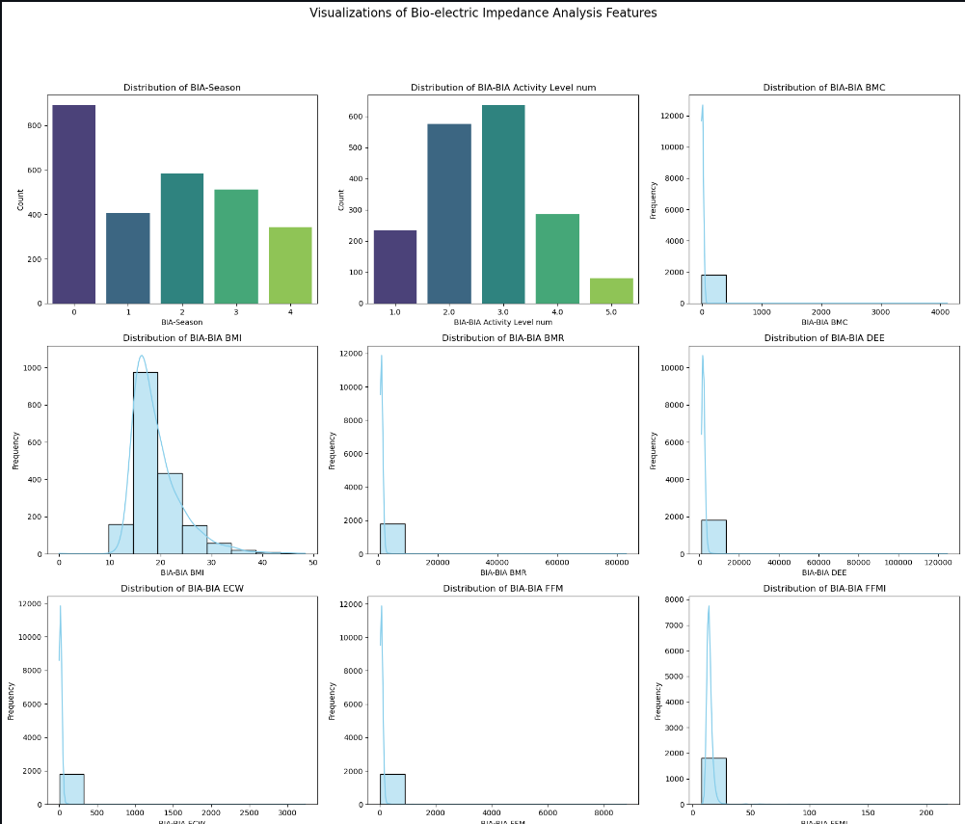
23
EC 9560 DATA MINING| 2024

Slide 24
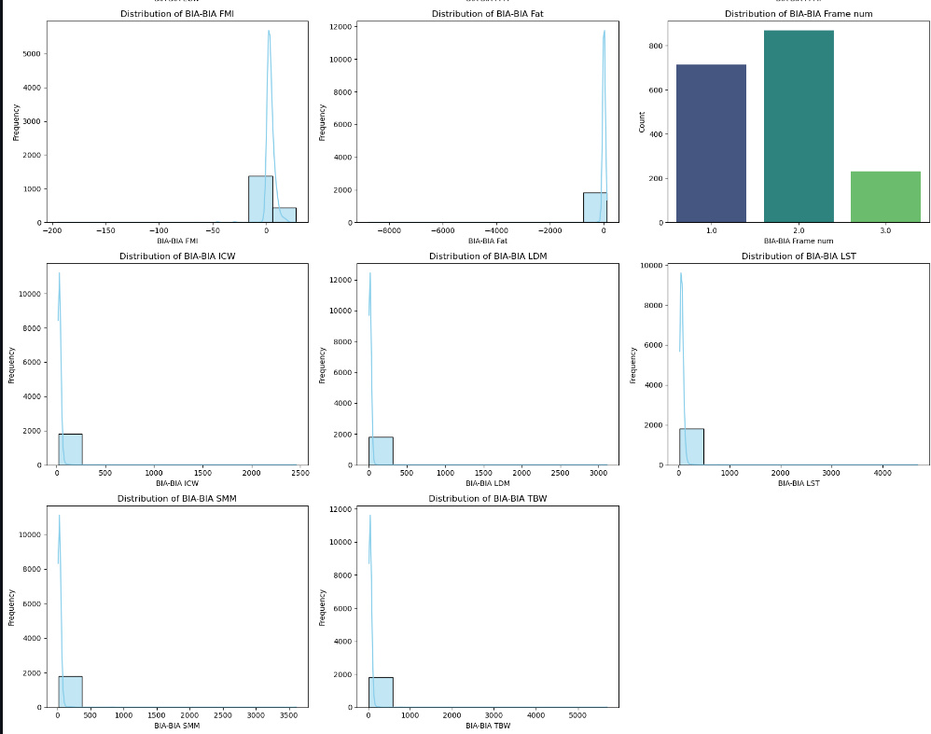
24
EC 9560 DATA MINING| 2024

Slide 25
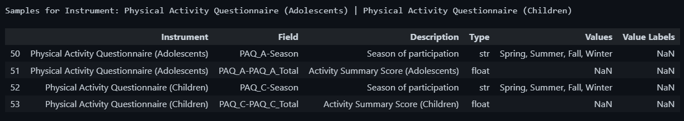
25
PHYSICAL ACTIVITY QUESTIONNAIRE
EC 9560 DATA MINING| 2024

Slide 26
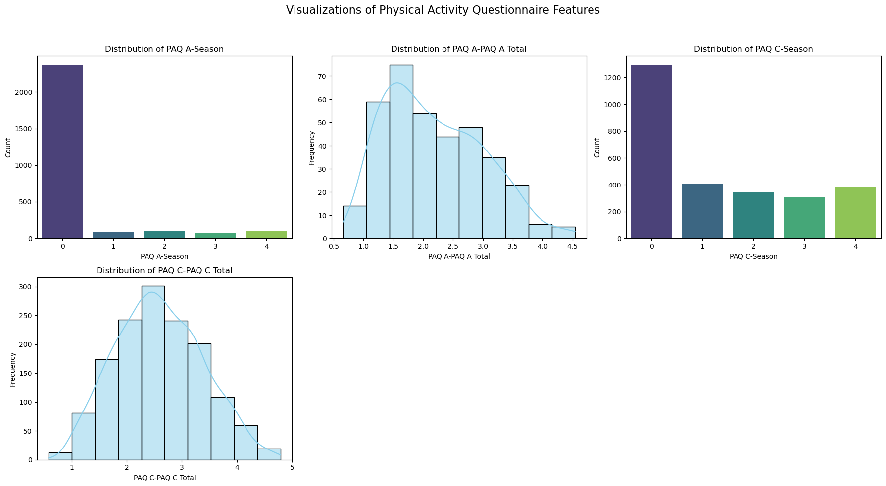
26
EC 9560 DATA MINING| 2024

Slide 27
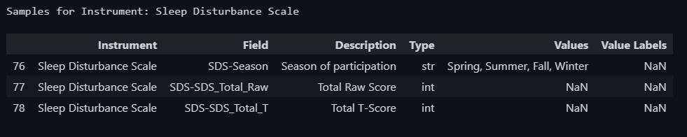
27
SLEEP DISTURBANCE SCALE
EC 9560 DATA MINING| 2024

Slide 28
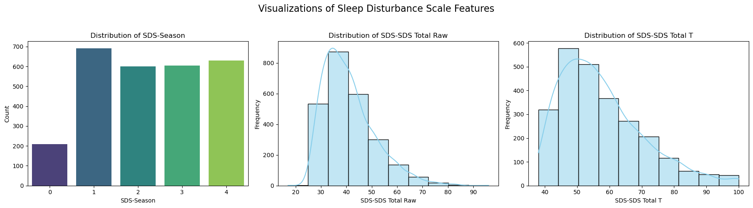
28
EC 9560 DATA MINING| 2024

Slide 29
29
CORRELATIONS
Given the large number of available features, I decided to perform feature selection to assess its impact on the model.
Here, I selected features with the strongest correlation to the PCIAT total score, discarding those with weaker correlations.
EC 9560 DATA MINING| 2024

Slide 30
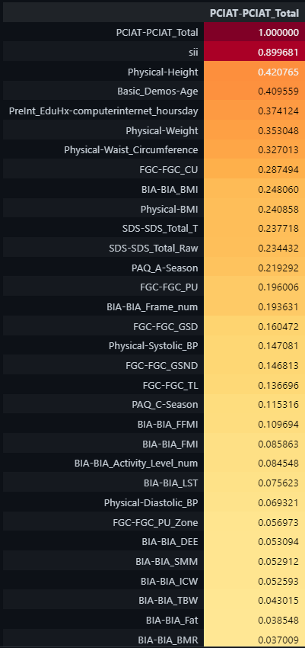
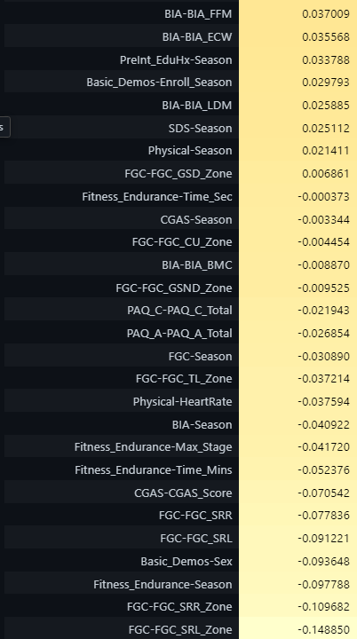
30
EC 9560 DATA MINING| 2024

Slide 31
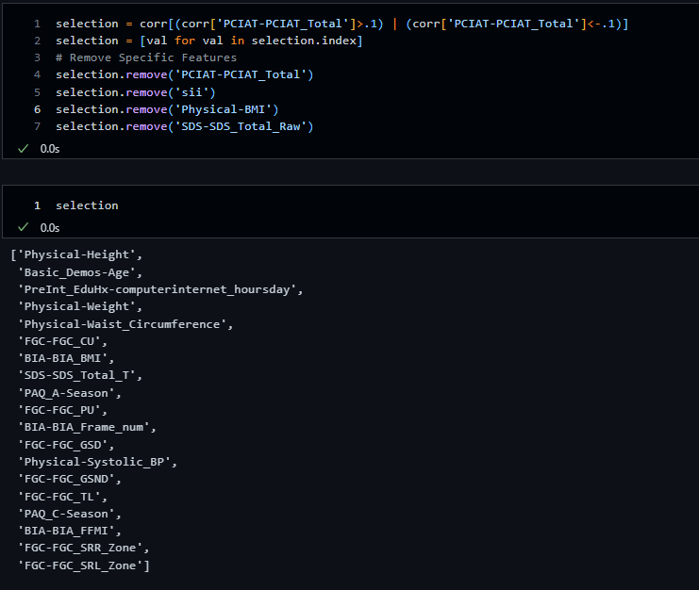
31
EC 9560 DATA MINING| 2024

Slide 32
32
MISSING VALUES
The dataset contains a significant number of missing values.
46 columns have missing values.
8 columns have more than 50% of their values missing.
I will drop the columns that have more than half of their values missing.
EC 9560 DATA MINING| 2024

Slide 33
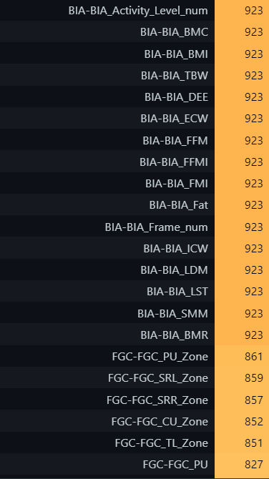
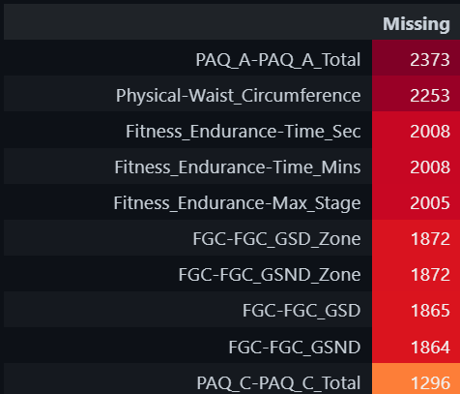
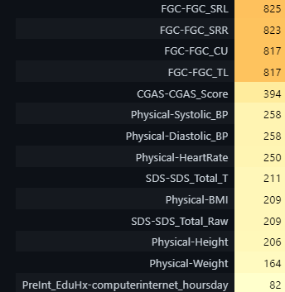
33
EC 9560 DATA MINING| 2024

Slide 34
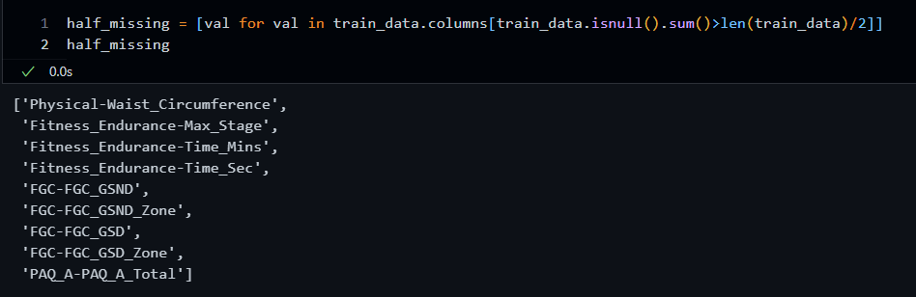
34
EC 9560 DATA MINING| 2024

Slide 35
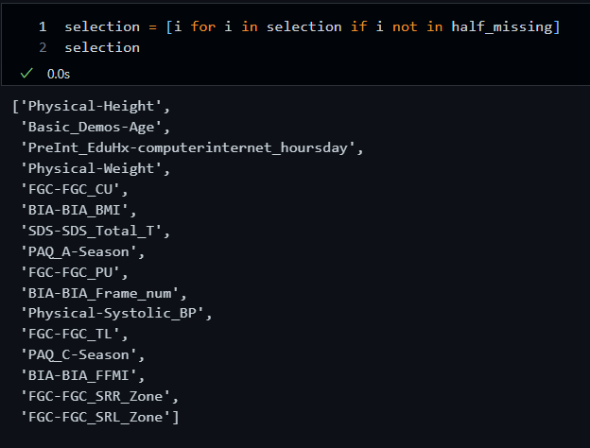
35
FINAL SELECTED FEATURES
EC 9560 DATA MINING| 2024

Slide 36
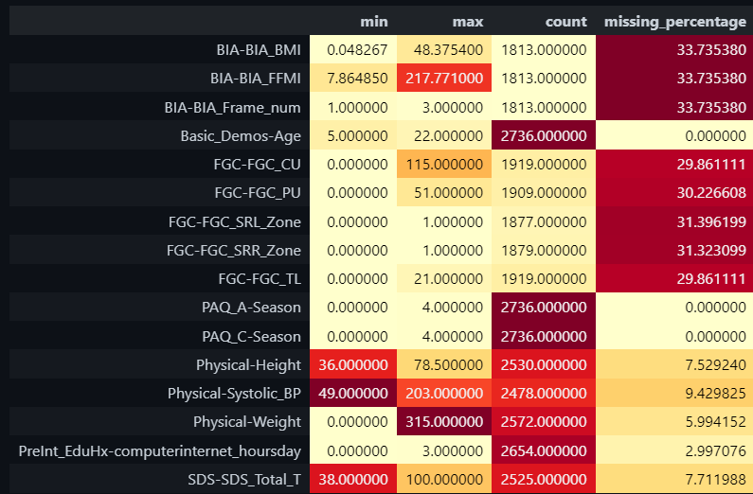
36
EC 9560 DATA MINING| 2024

Slide 37
37
Handling Missing Values
1. For Features with Less than 10% Missing Values
Numerical Features: Apply mean or median imputation to replace missing values.
Categorical Features: Use mode imputation to fill missing values.
2. For Features with More than 10% Missing Values
Create Indicator Variable: Add a binary indicator to specify whether a value was missing.
Impute Missing Values:
For Numerical Features: Use mean or median imputation.
For Categorical Features: Use mode imputation.
Data Normalization
After handling missing values, Min-Max scaling will be applied to numerical features to standardize data across a 0–1 range, ensuring consistent scales across features.

Slide 38
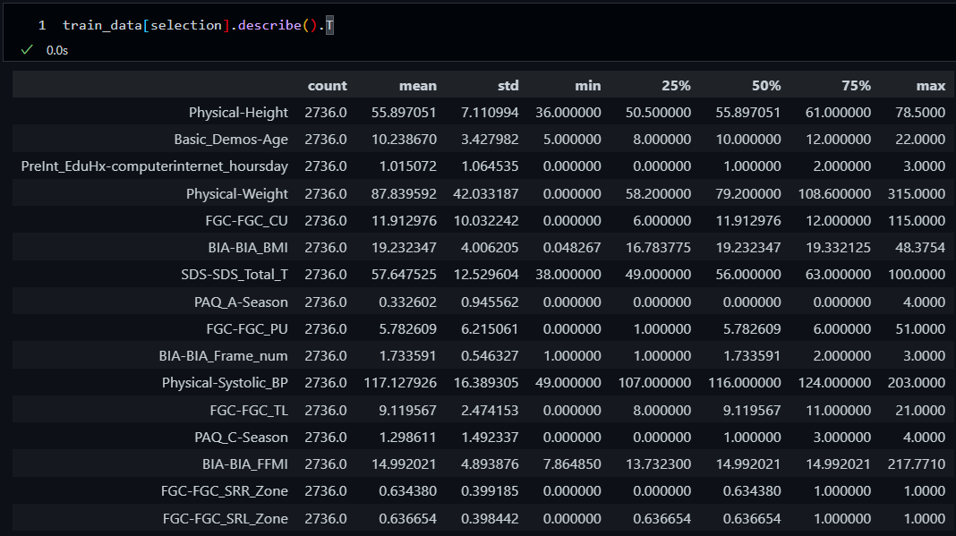
38
HANDLING MISSING VALUES
EC 9560 DATA MINING| 2024

Slide 39
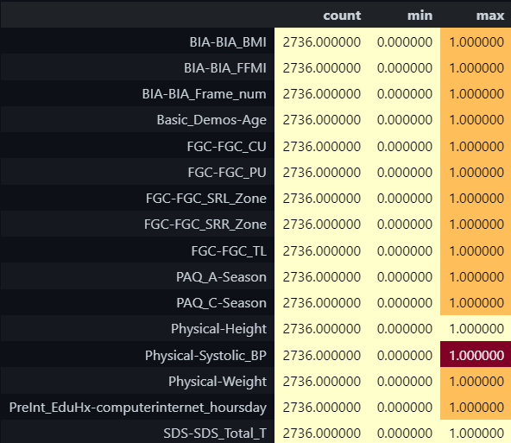
39
DATA NORMALIZATION WITH MIN-MAX SCALER
EC 9560 DATA MINING| 2024

Slide 40
EC 9560 DATA MINING| 2024
THANK YOU
Presented By : 2020/E/027

